Slide 1

Molecular Fingerprints & use of Unsupervised Algorithm
Submitted to -
Prof. Piyush Wanjari,
VNIT, Nagpur
Submitted by -
BT19CME054 Deepshikha Ingle
BT19CME068 Meetu Jhirwal
BT19CME0104 Suraj Shelke

Slide 2

TABLE OF CONTENTS
01
02
What is molecular fingerprints?
Methods to find similarity between molecules
RDkit
K means clustering
03
04

Slide 3
Objective
Acknowledge about
Molecular fingerprints
Algorithms used
Visualize the result of clustering as heatmap

Slide 4
01
What is Molecular Fingerprints?
Introduction

Slide 5
Overview
The notion of chemical similarity(or molecular similarity) play an important role in predicting the properties of chemical compounds, designing chemicals with a predefined sets of properties and especially conducting drug design studies. Calculation of the similarity of any two molecules is achieved by comparing their molecular fingerprints,

Slide 6
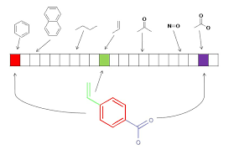
Molecular Fingerprints and Similarity Searching
It is a fixed length bit string where each bit represents a specific molecular substructure feature as a substructure property.

Slide 7
Tanimoto Coefficient
In the Tanimoto algorithm A and B are the sets of fingerprint bits on in the fingerprints of molecule A and molecule B. AB is the set of common bits of fingerprints both molecule of A and B. the Tanimoto coeff. Ranges from 0 when the fingerprints have no bits in common, to the 1 when the fingerprints are identical

Slide 8
Categories
2
02
1
01
3
03
Non-iterative single reference searches- One against one similarity measures i.e. bit weighing
Data fusion of similarity coefficients,
Iterative similarity search

Slide 9

RDKit
0
RDkit is the python library where you deal with the chemical data. It is one of popular toolkit that helps you to calculate similarities of molecules directly.

Slide 10

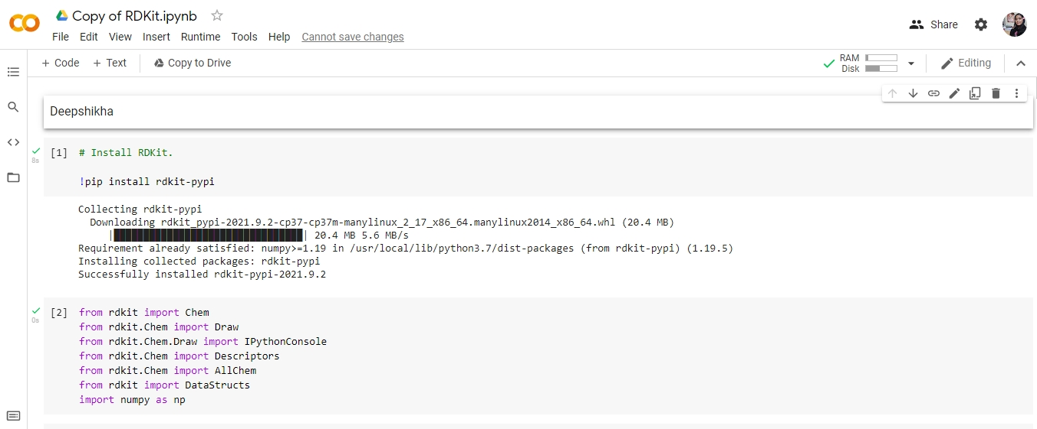

Slide 11
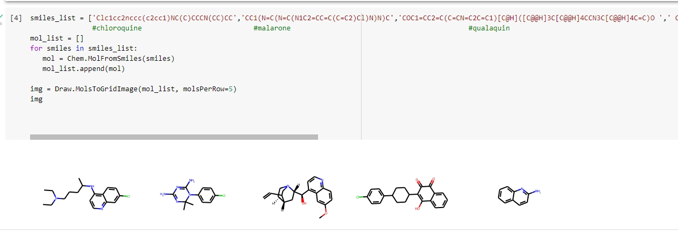

Slide 12
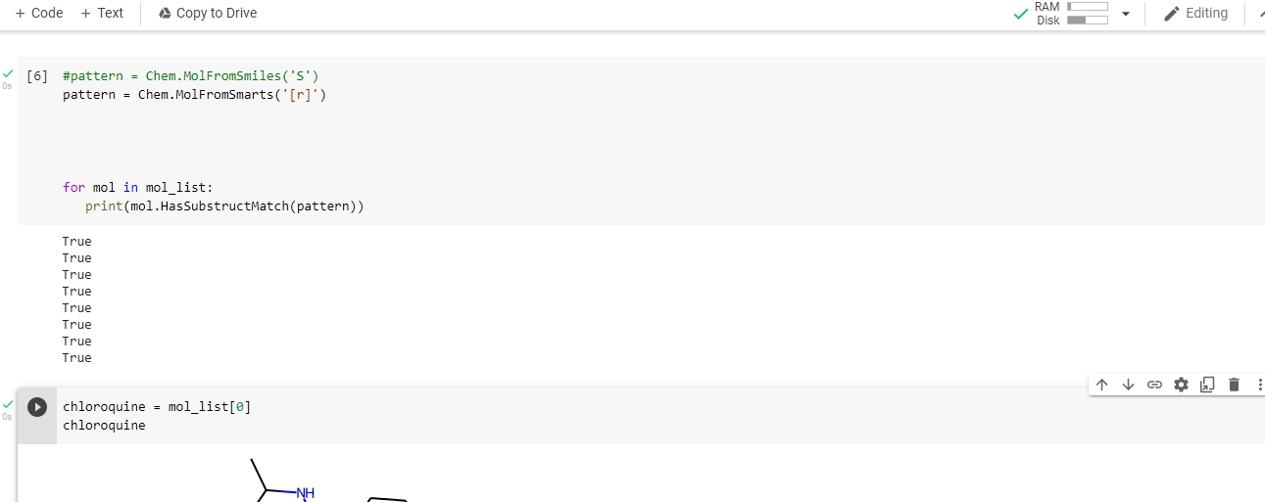
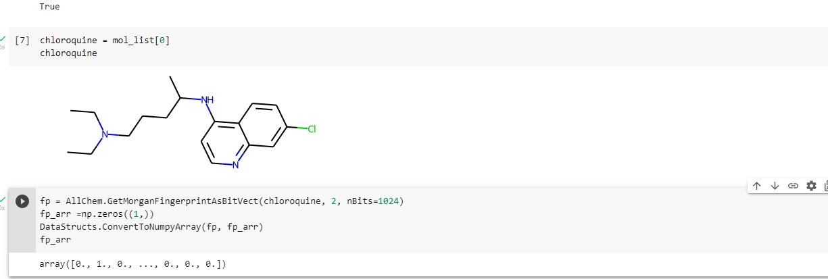

Slide 13
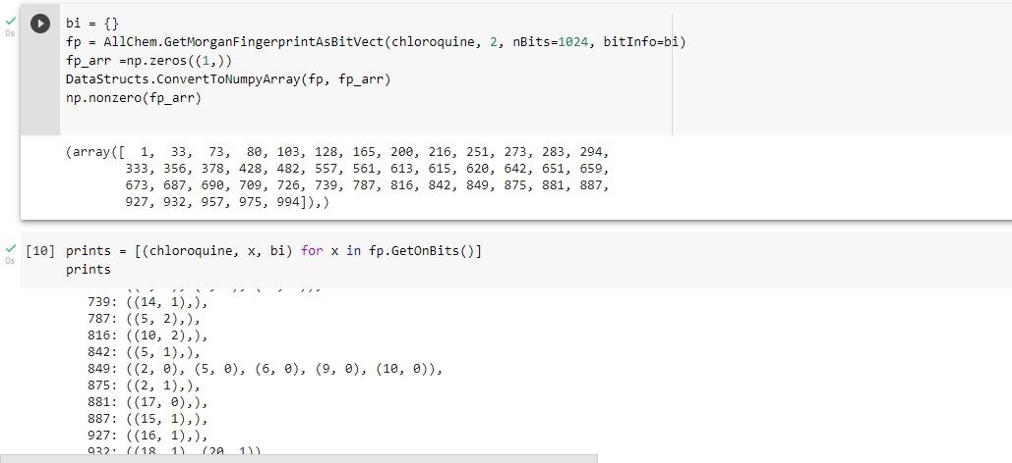

Slide 14
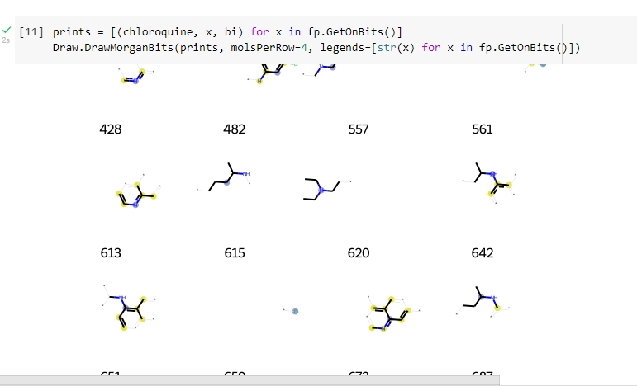

Slide 15
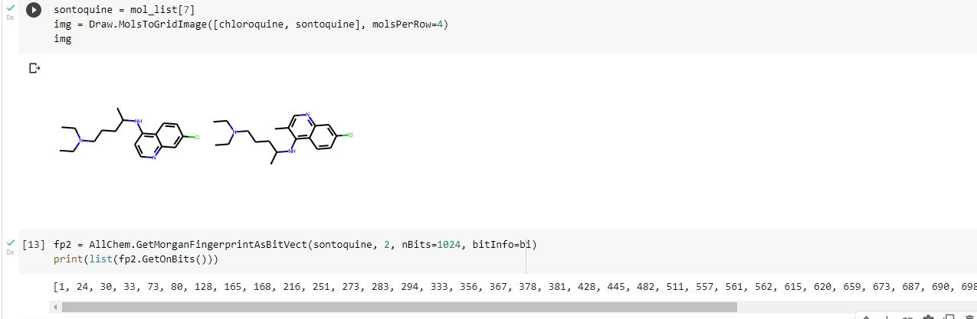

Slide 16
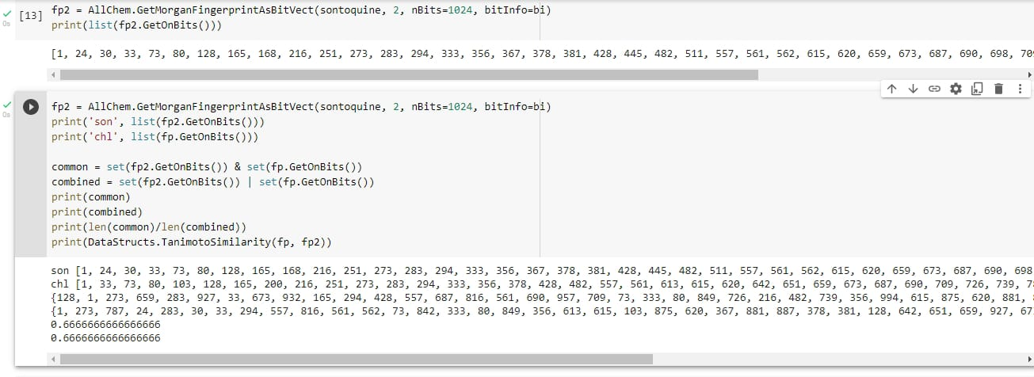

Slide 17
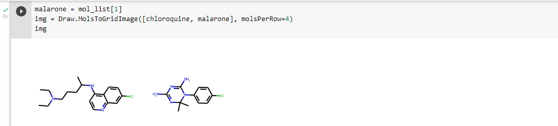
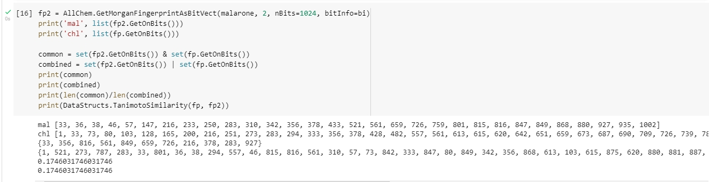

Slide 18
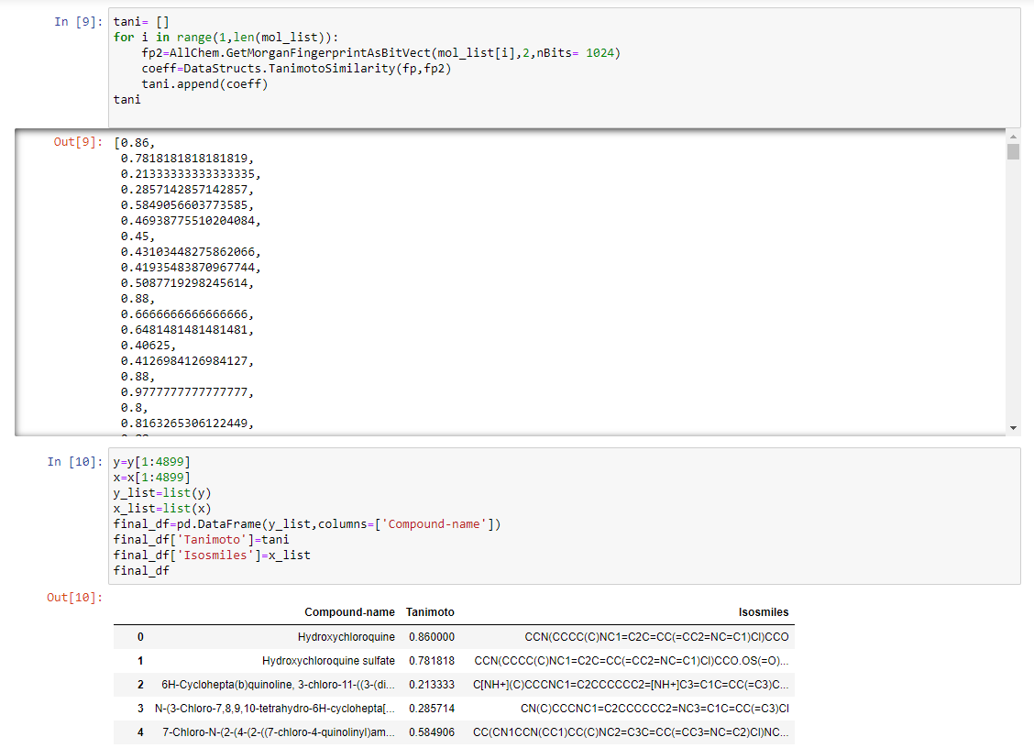

Slide 19
K Means Clustering

Slide 20
Contents
What is Clustering
What is K Means Algorithm
Diagrammatic Implementation of K Means Clustering
Choose the right number of Cluster
Python Implementation

Slide 21
What is Clustering?
The technique to segregate Datasets into various groups, on the basis of having similar features and characteristics, is being called Clustering.

Slide 22
K Means Algorithm
03
K means Algorithm is an Iterative algorithm that divides a group of n datasets into k subgroups /clusters based on the similarity and their mean distance from the centroid of that particular subgroup/ formed.

Slide 23

Algorithm steps of K Means
Step 1
Step 2
Step 3
Select the value of K, to decide the number of clusters to be formed.
Select random K points which will act as centroids.
Assign each data point, based on their distance from the randomly selected points (Centroid), to the nearest/closest centroid which will form the predefined clusters.

Slide 24
Algorithm steps of K Means
Step 4
Step 5
Step 6
place a new centroid of each cluster..
Repeat step no.3, which reassign each datapoint to the new closest centroid of each cluster.
If any reassignment occurs, then go to step-4 else Finish.

Slide 25

04
Diagrammatic Implementation of K Means Clustering

Slide 26
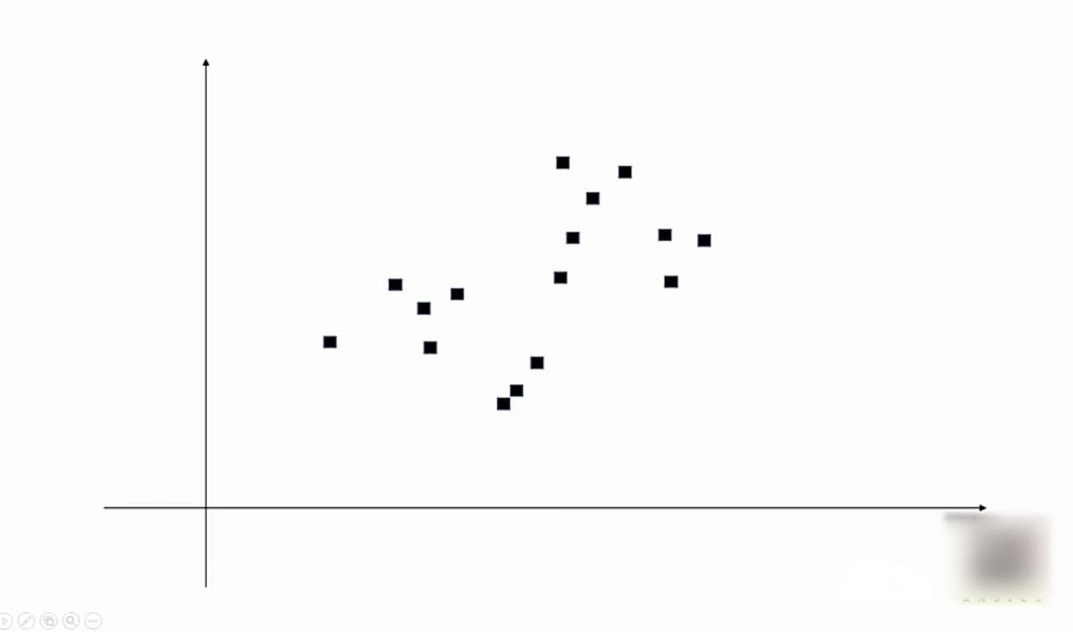
Set of points randomly arranged

Slide 27
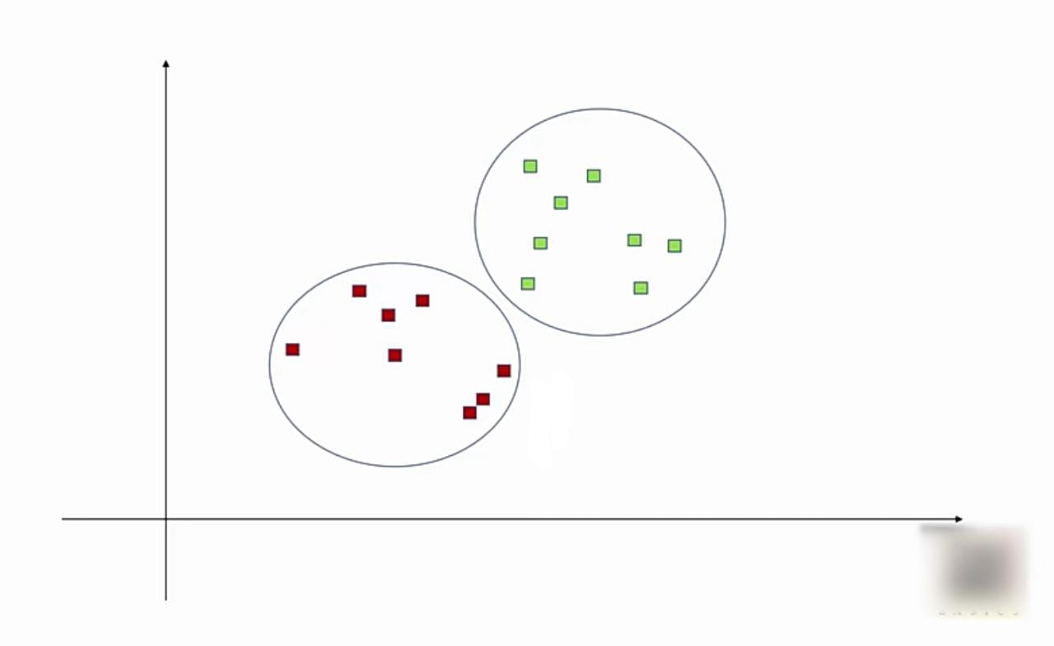

Slide 28
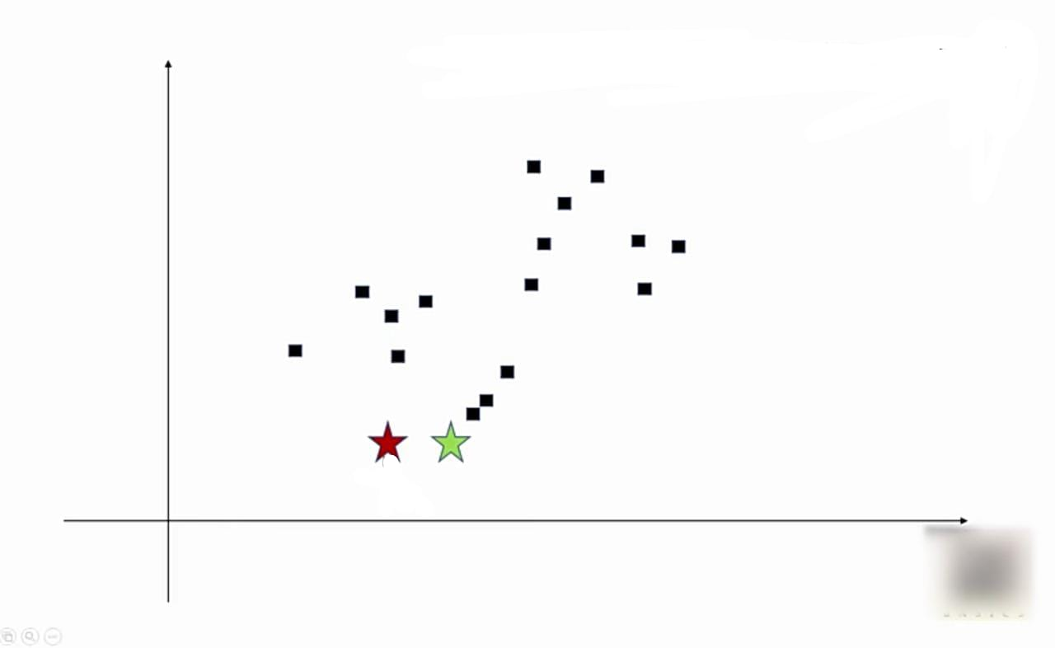
Start with K centroids by putting them at random place. Here k=2
Centroid 1 .
Centroid 2

Slide 29
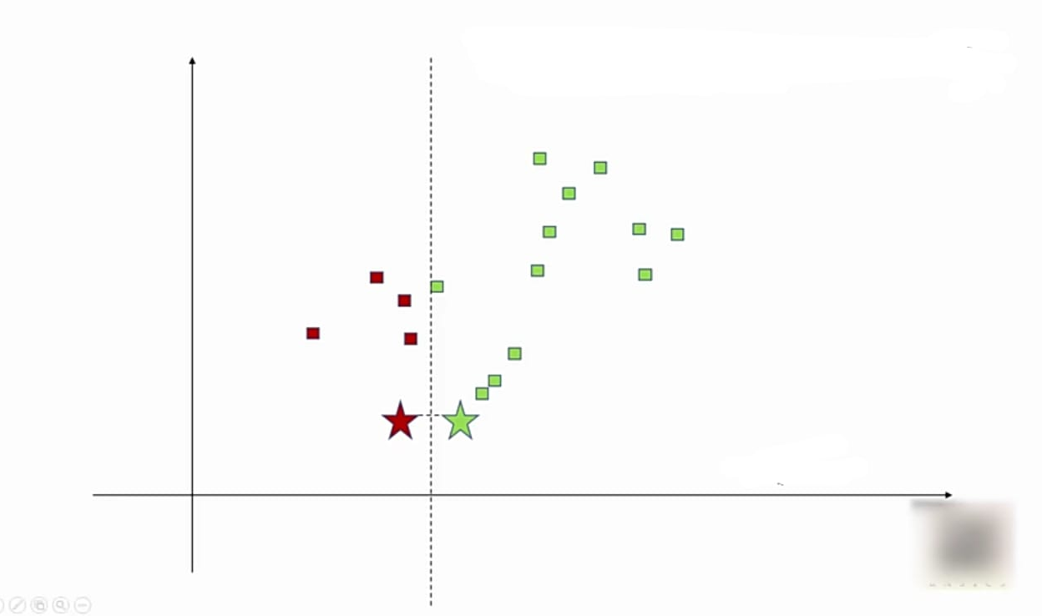
2. Compute distance of every point from centroid and cluster them accordingly

Slide 30
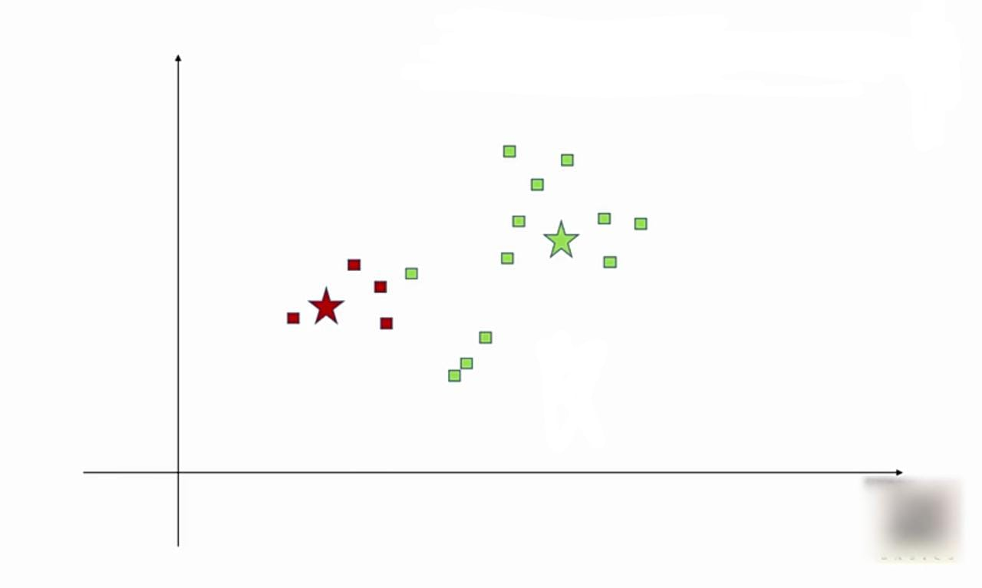
3. Adjust centroids so that they become centre of gravity for given cluster

Slide 31
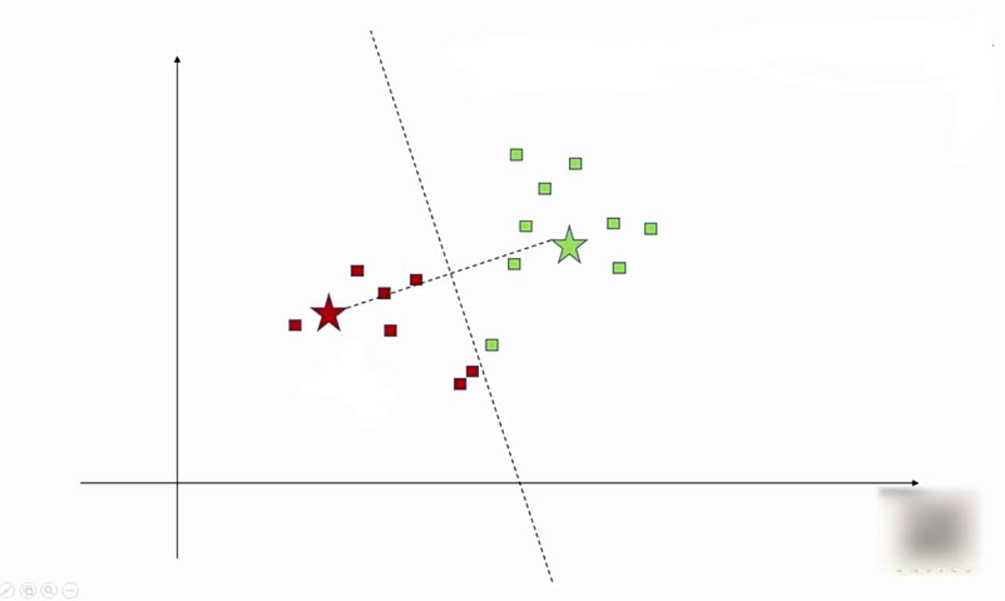
4. Again re-cluster every point based on their distance with centroid

Slide 32
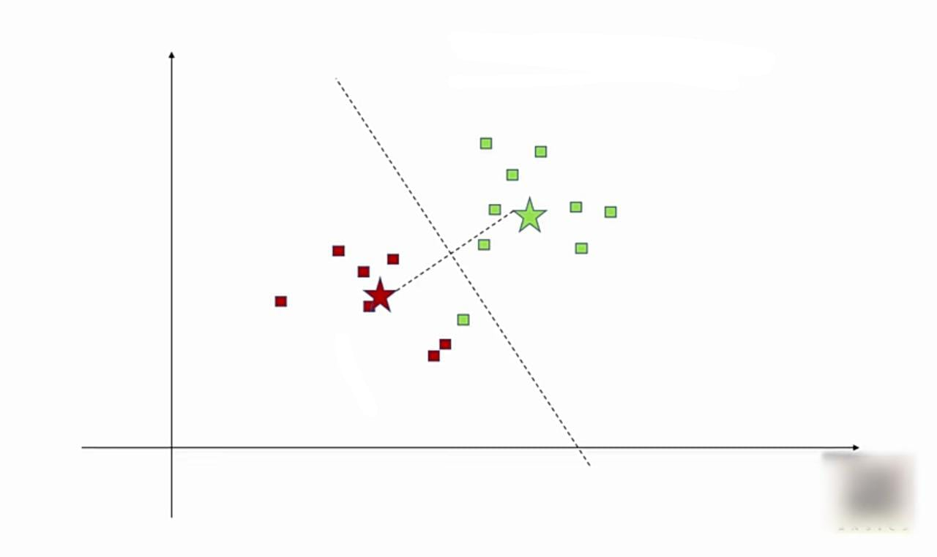
5. Again adjust centroids

Slide 33
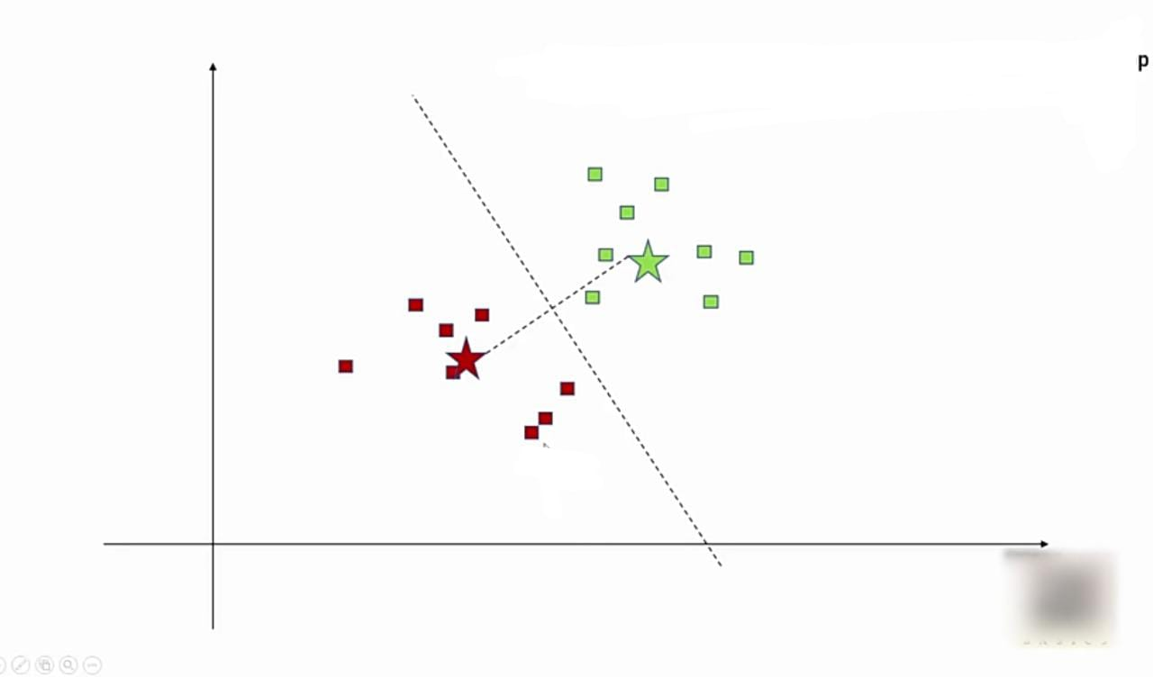
6. Recompute clusters and repeat this till data points stop changing clusters

Slide 35
Choosing the right no. of clusters

Slide 36
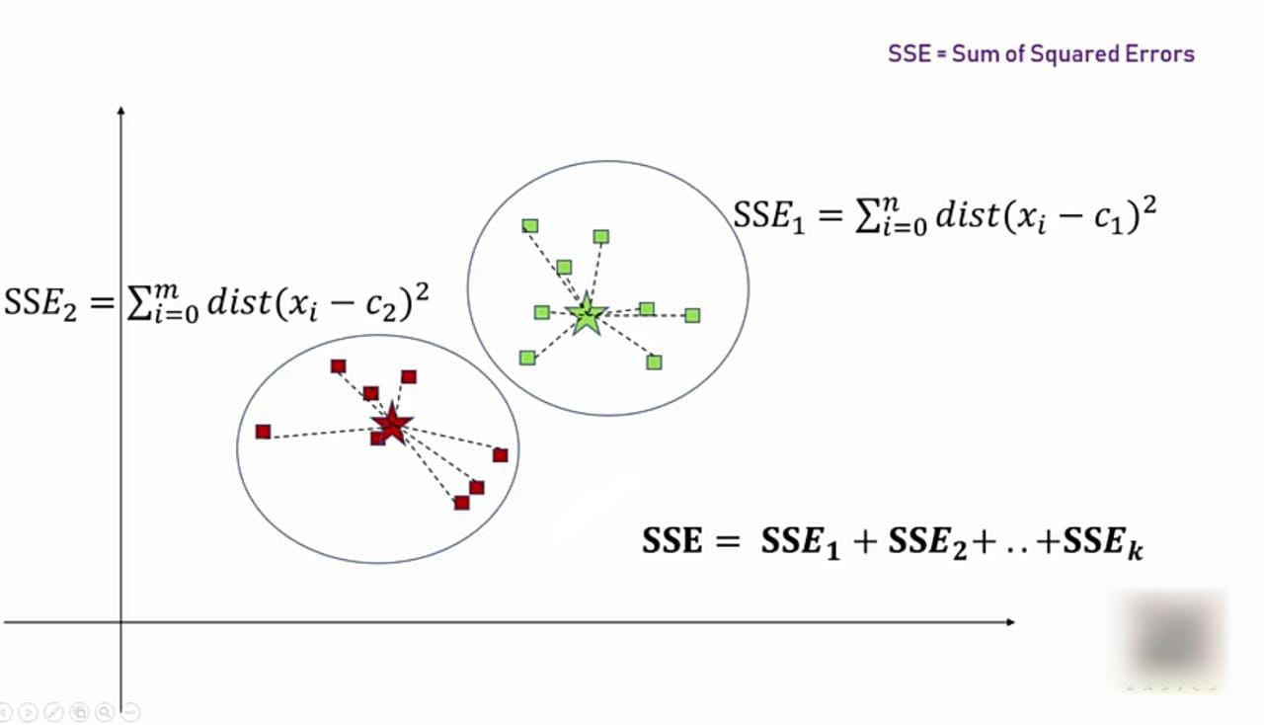

Slide 37
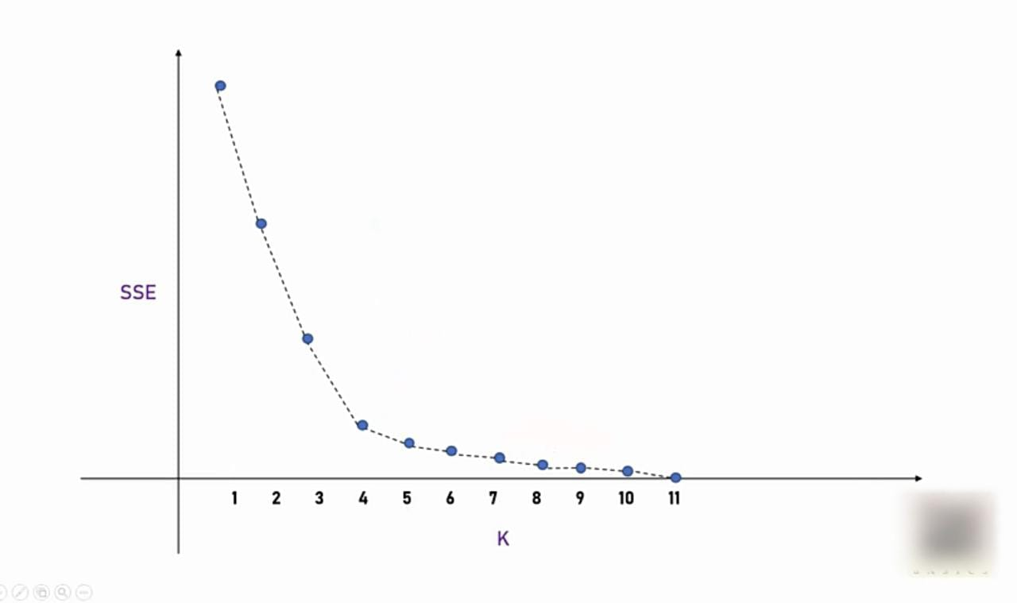

Slide 38
04
Python Implementation

Slide 39
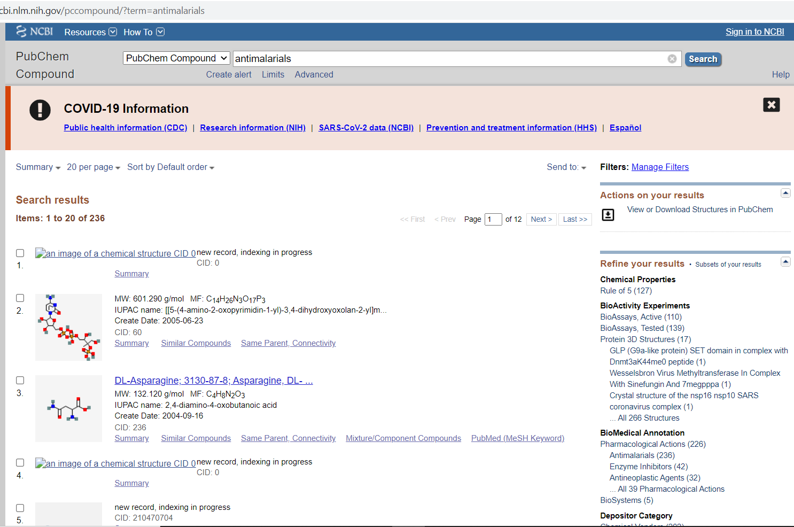
04

Slide 40
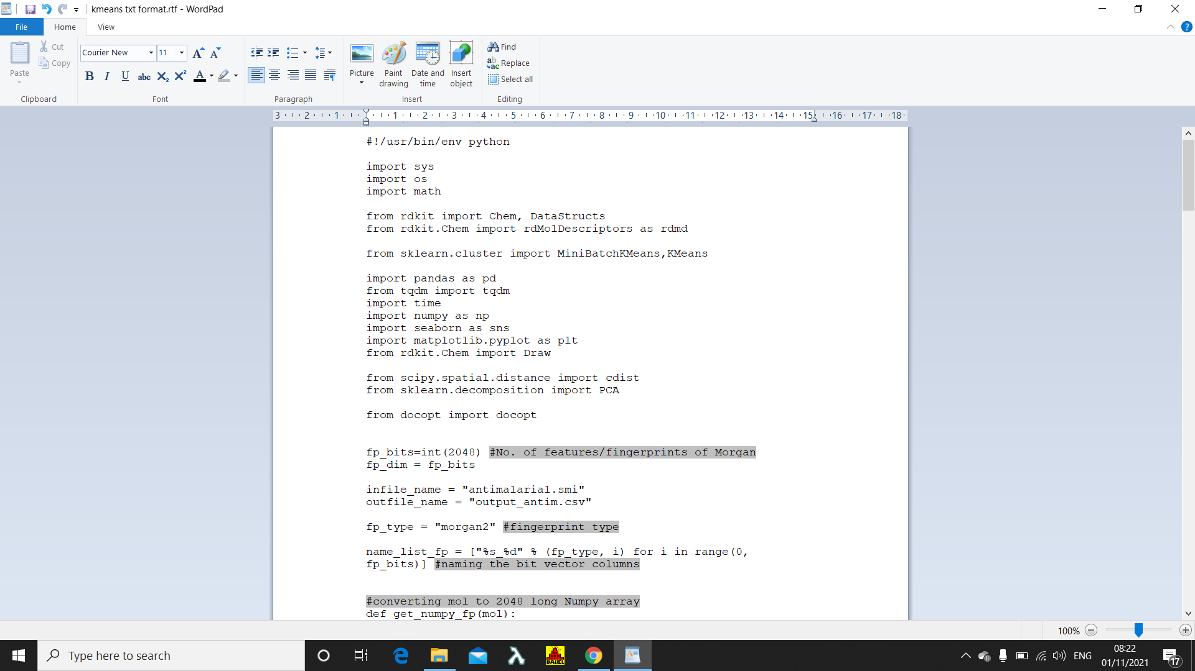
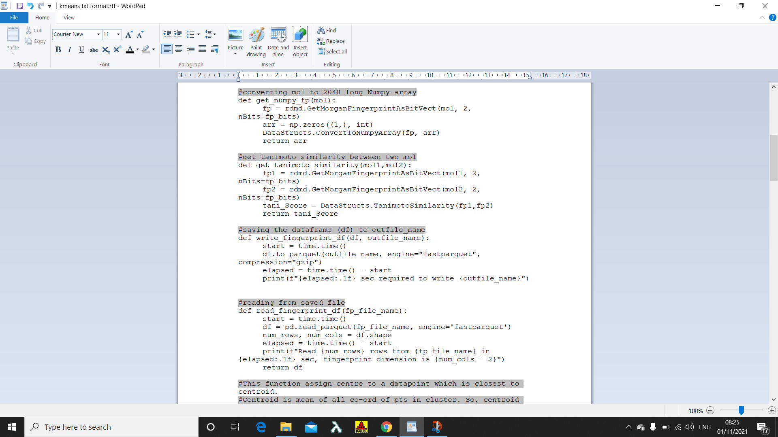

Slide 41
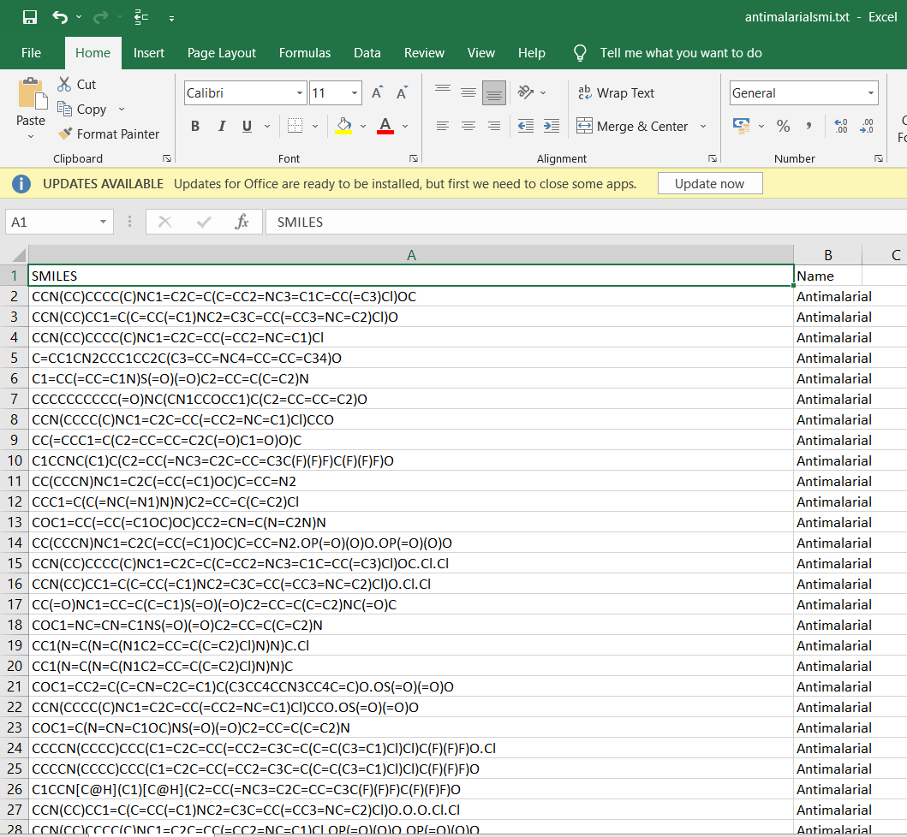

Slide 42
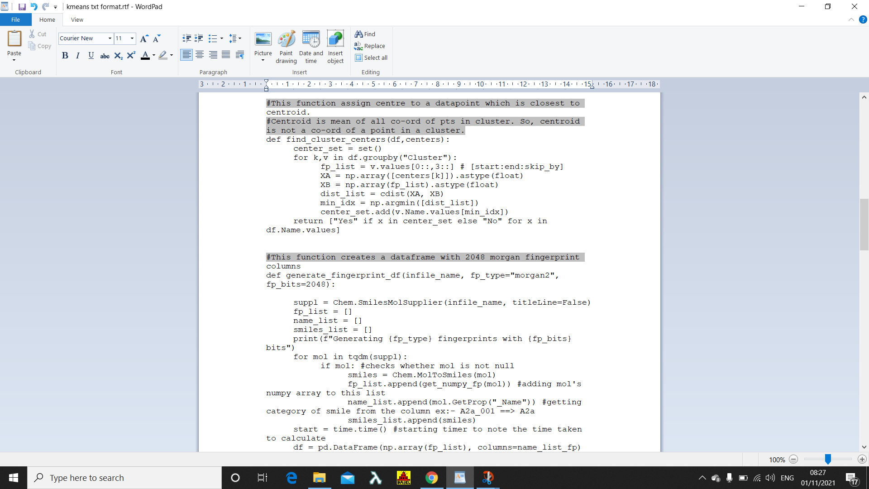
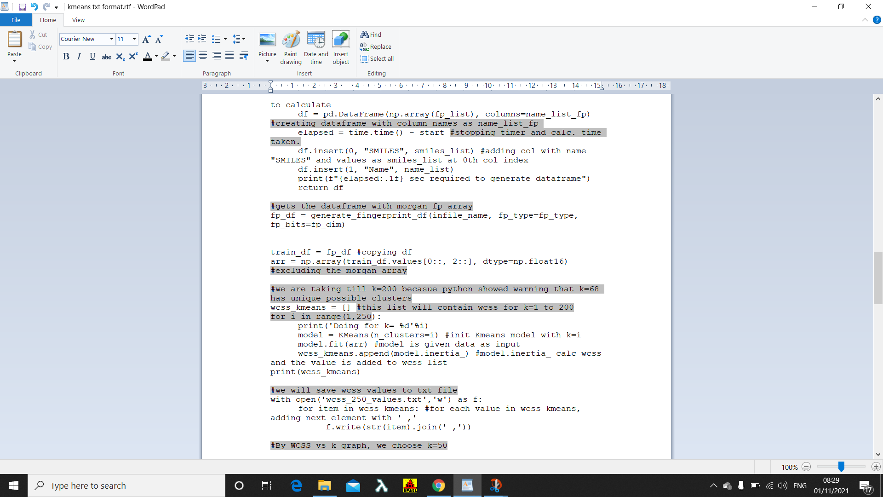

Slide 43
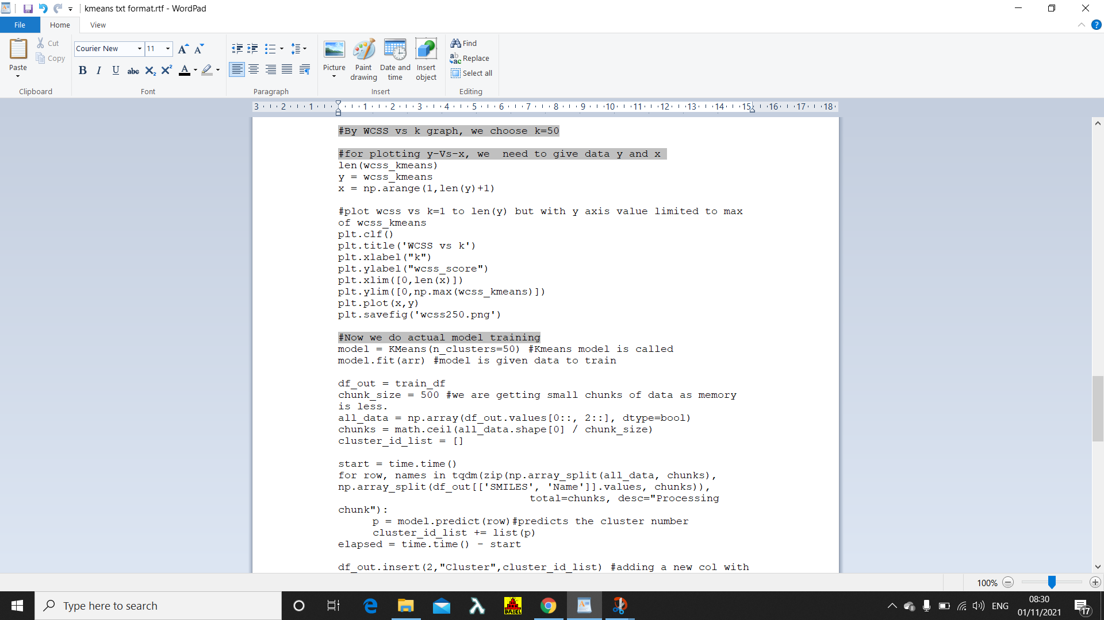
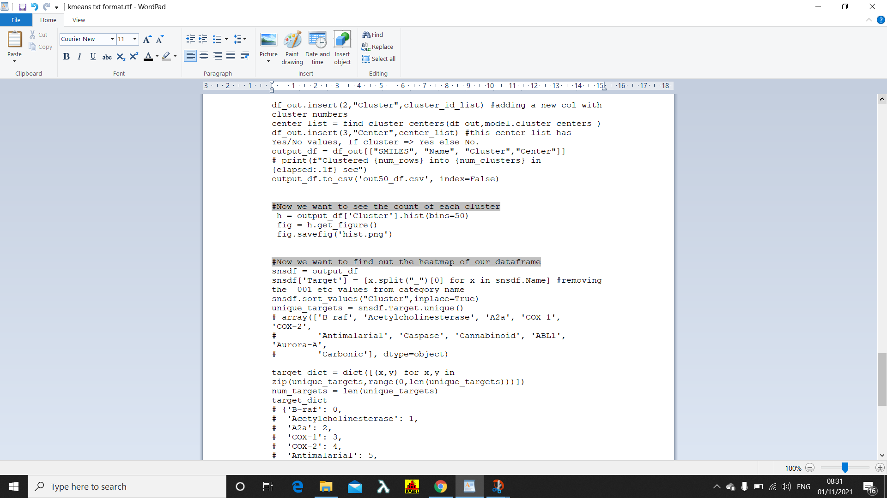

Slide 44
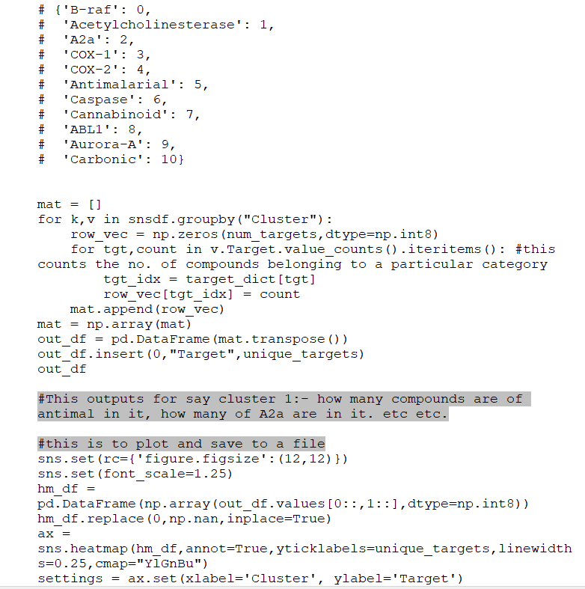

Slide 45
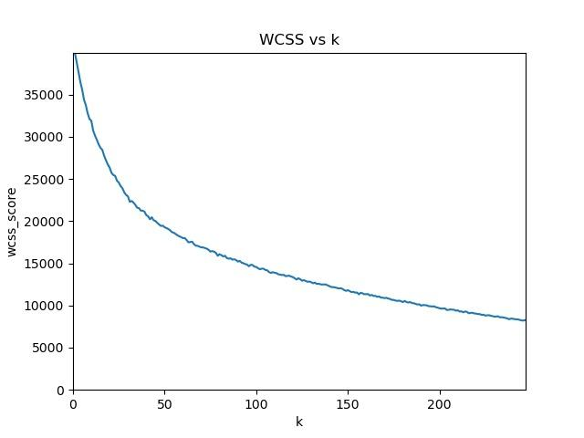

Slide 46
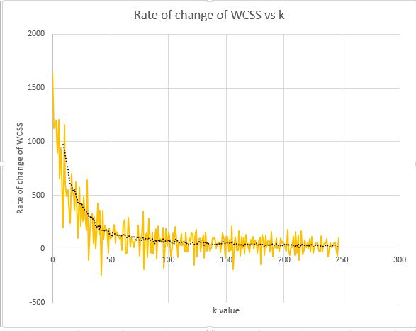
Rate of change of WCSS vs K-value

Slide 47
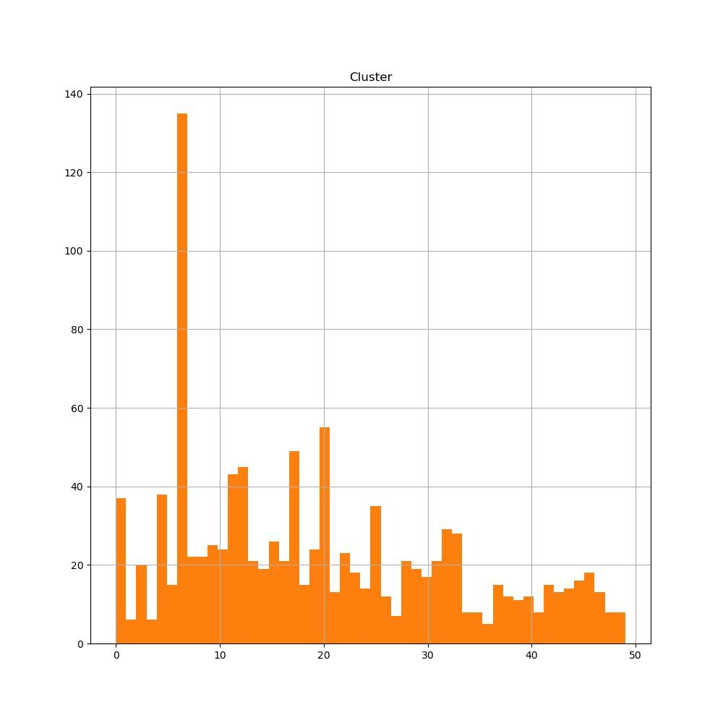

Slide 48
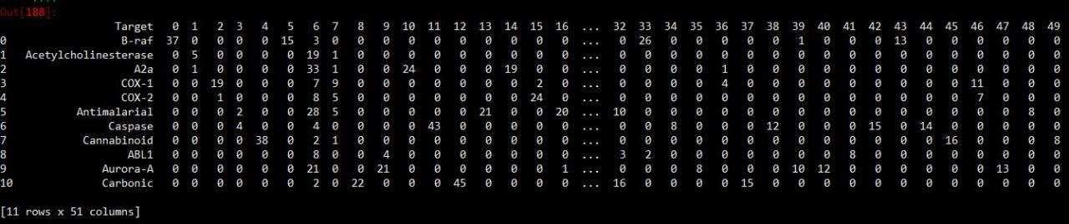

Slide 49
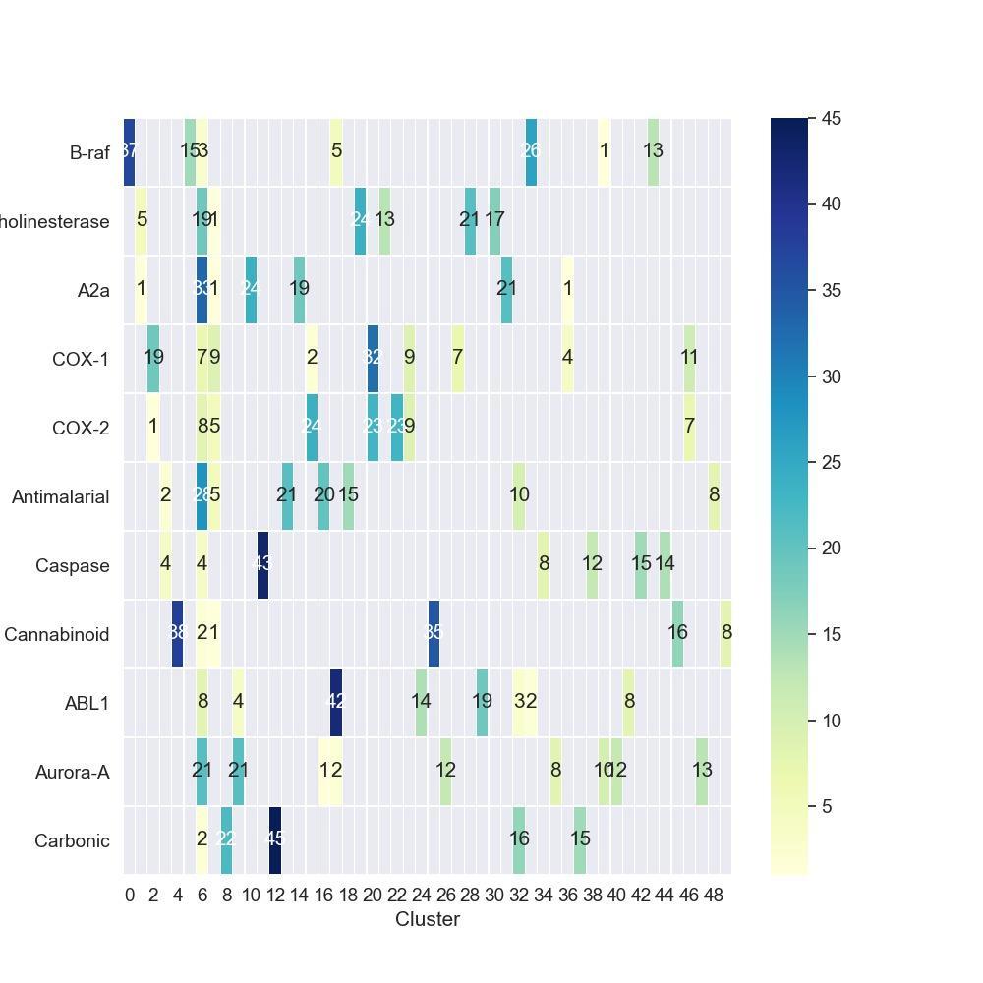
Heat Map

Slide 50
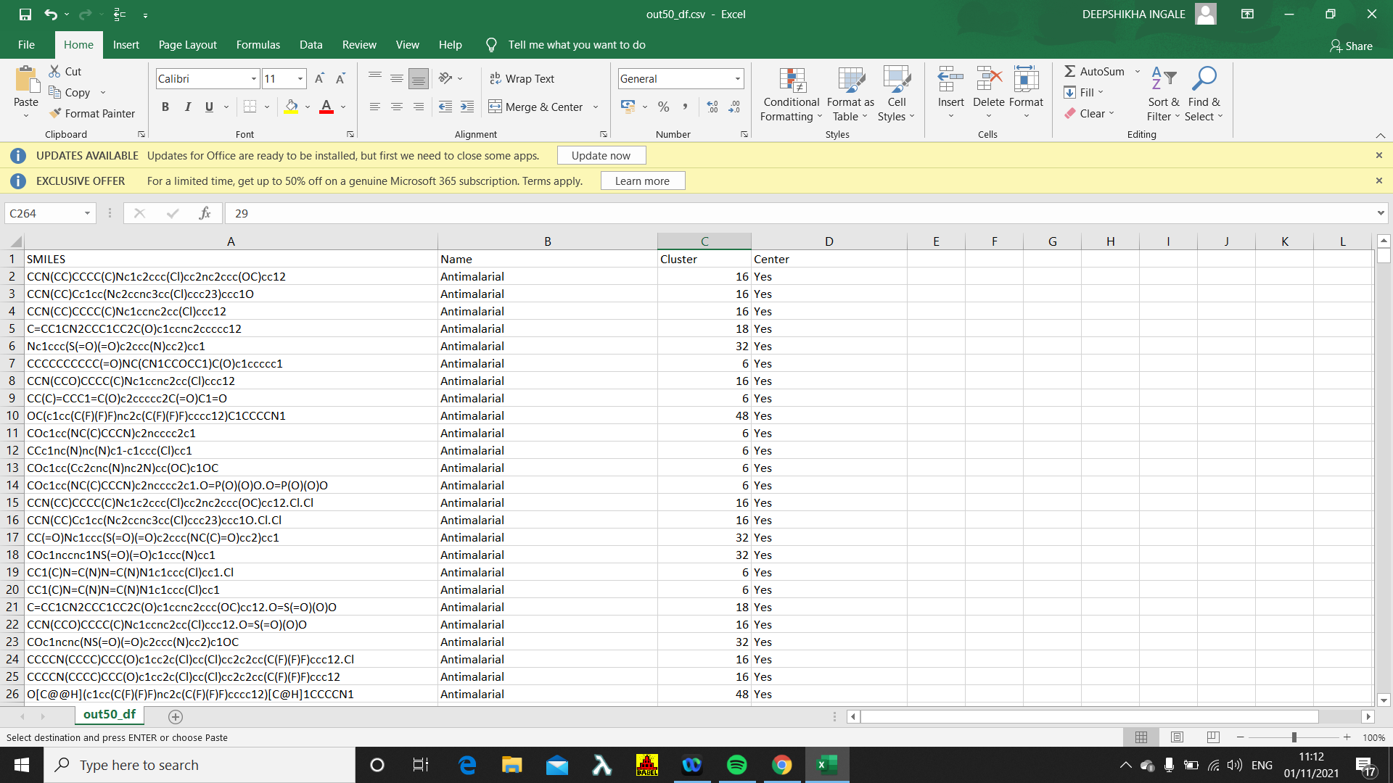
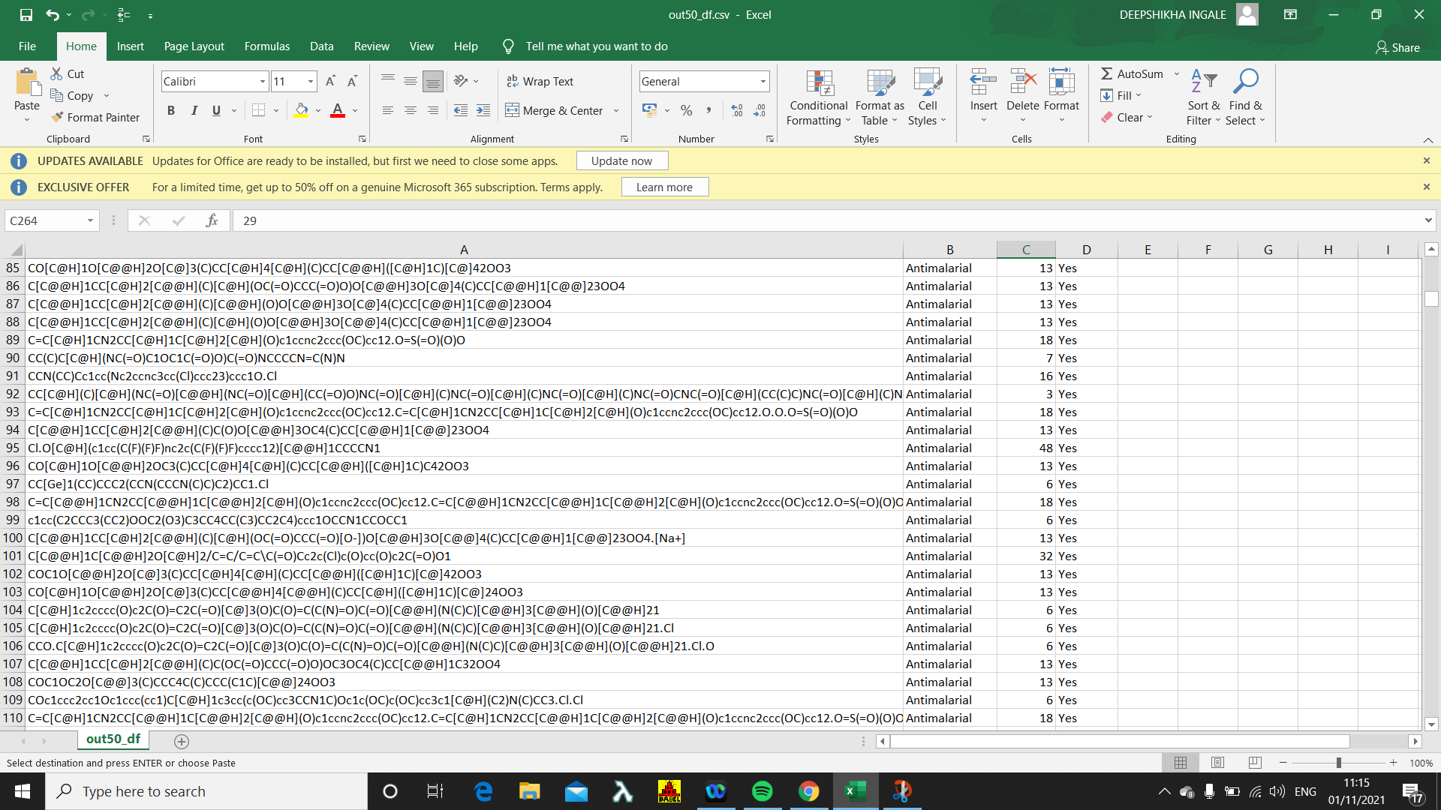

Slide 51
Conclusion
Approx 130 data points belong to the 6th cluster so we can conclude that there is very less variation we have i n that custer i.e they are similar.
Case1. You know the category of that compound then from the heatmap we will look in that category and check for the cluster numbers shown in that row
Case2 you do not know the category then you need to computations for all the 50 clusters.

Slide 52
Thank you :)

